Slide 1
BIKE SALES PERFORMANCE
HASMATH NASEEMA

Slide 2
PROJECT PURPOSE
OBJECTIVE: Analyze bike buyer behavior to identify key purchase drivers and summarize findings in an interactive dashboard.
CONTEXT: A retail dataset captures customer demographics and commute patterns. We want to understand what influences purchase decisions and which segments to target.

Slide 3
DATA OVERVIEW
📁 Dataset: Bike Buyers dataset with demographics, income, region,marital status and purchase outcome (Yes/No).
🧮 Size: Original file had duplicate customer IDs; after removing duplicates we analyze 1,000 unique customers.
🧰 Tools: Google Sheets for cleaning, PivotTables, charts, slicers, and dashboard KPIs.

Slide 4
DATA CLEANING
Removed duplicate customers (deduped on ID: 1,026 → 1,000).
Checked missing values and corrected inconsistent text (Yes/No, region names).
Standardized numeric columns (Income, Age, Cars) and applied proper formats.
Validated categorical fields (Gender, Occupation, Commute Distance).

Slide 5
PIVOT TABLES
Gender × Purchased Bike (Yes/No) → unit counts by gender.
Region × Purchased Bike (Yes/No) → unit counts by region.
Occupation × Purchased Bike (Yes/No) → unit counts by occupation.
Average Income by Purchase (Yes vs No) and by Gender.

Slide 6
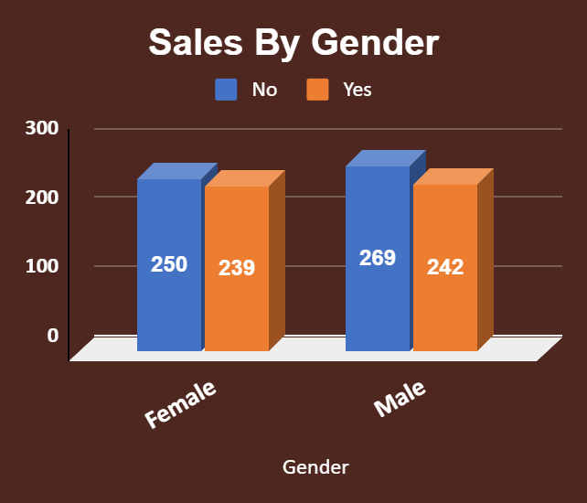
SALES BY GENDER
📌 Purchases are balanced
across genders,with a slight
edge for male buyers.

Slide 7
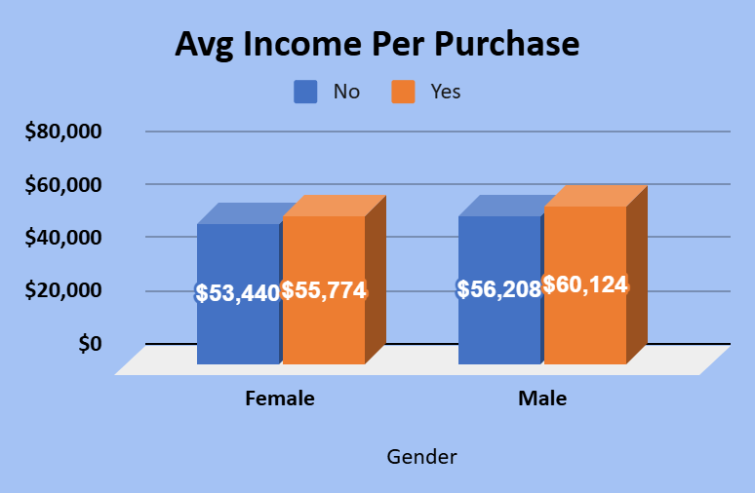
INCOME & PURCHASE
📌 Buyers have higher average
income than non-buyers
for both genders
(income is a strong driver).

Slide 8
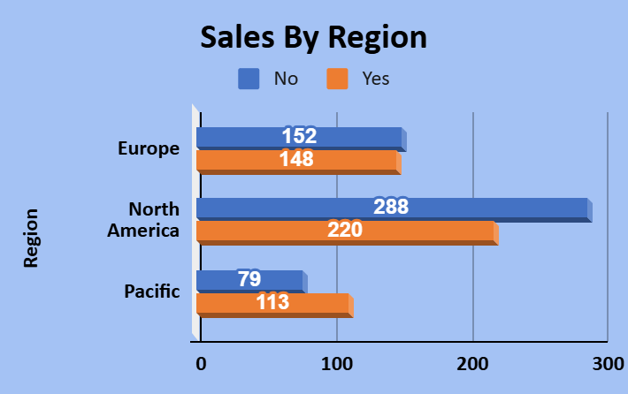
SALES BY REGION
📌 North America has the
highest purchase volume,
while Pacific shows
the highest buyer rate.

Slide 9
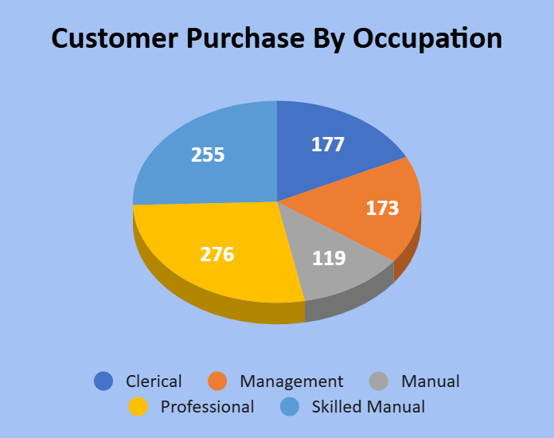
OCCUPATION & PURCHASE
📌 Professionals purchase
the most bikes and also
show the strongest conversion
among occupation

Slide 10
Key takeaways
Buyer rate is 48.1% (481 purchases out of 1000).
Buyers earn more on average than non-buyers (income influences purchase).
North America leads purchase volume; Pacific has the strongest conversion.
Professionals are the highest-converting occupation segment.

Slide 11
CONCLUSION
Recommended actions
Regional segments with tailored offers.
• Allocate campaigns to North America for volume, Pacific for efficiency.
• Collect price/quantity to calculate true revenue and profit.

